Slide 1
The Mathematical Beauty of Computer Science
Tom Ball
Microsoft Research

Slide 2
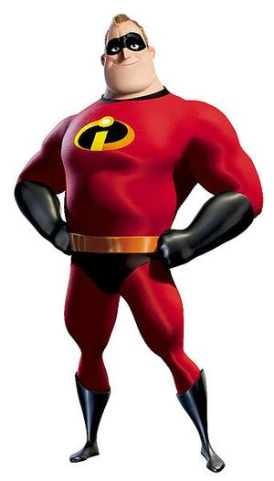

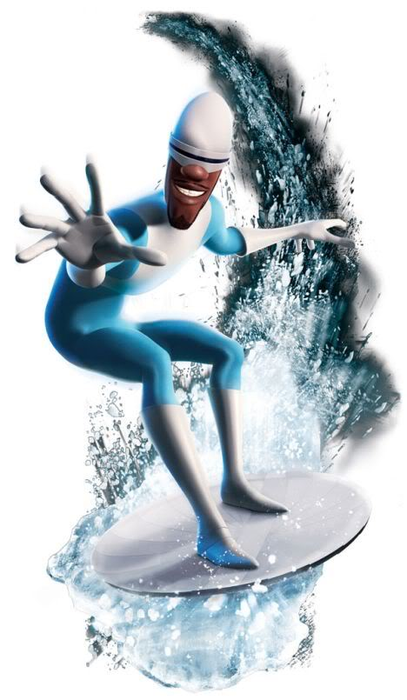
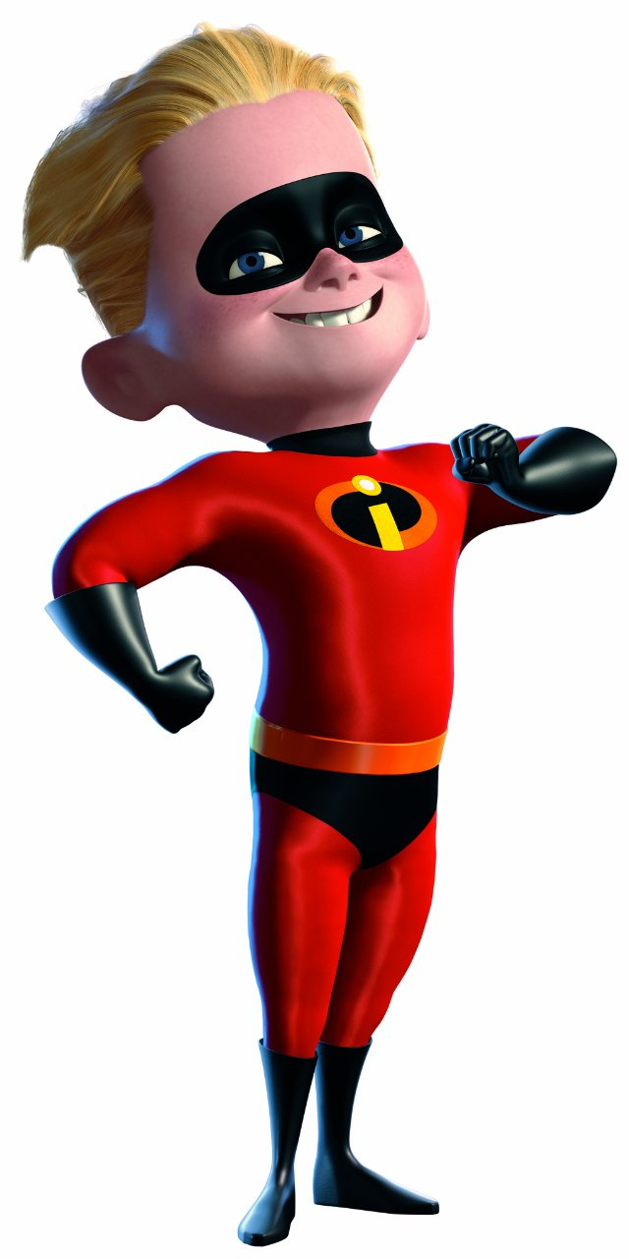
Which superhero does Tom resemble most?

Slide 3
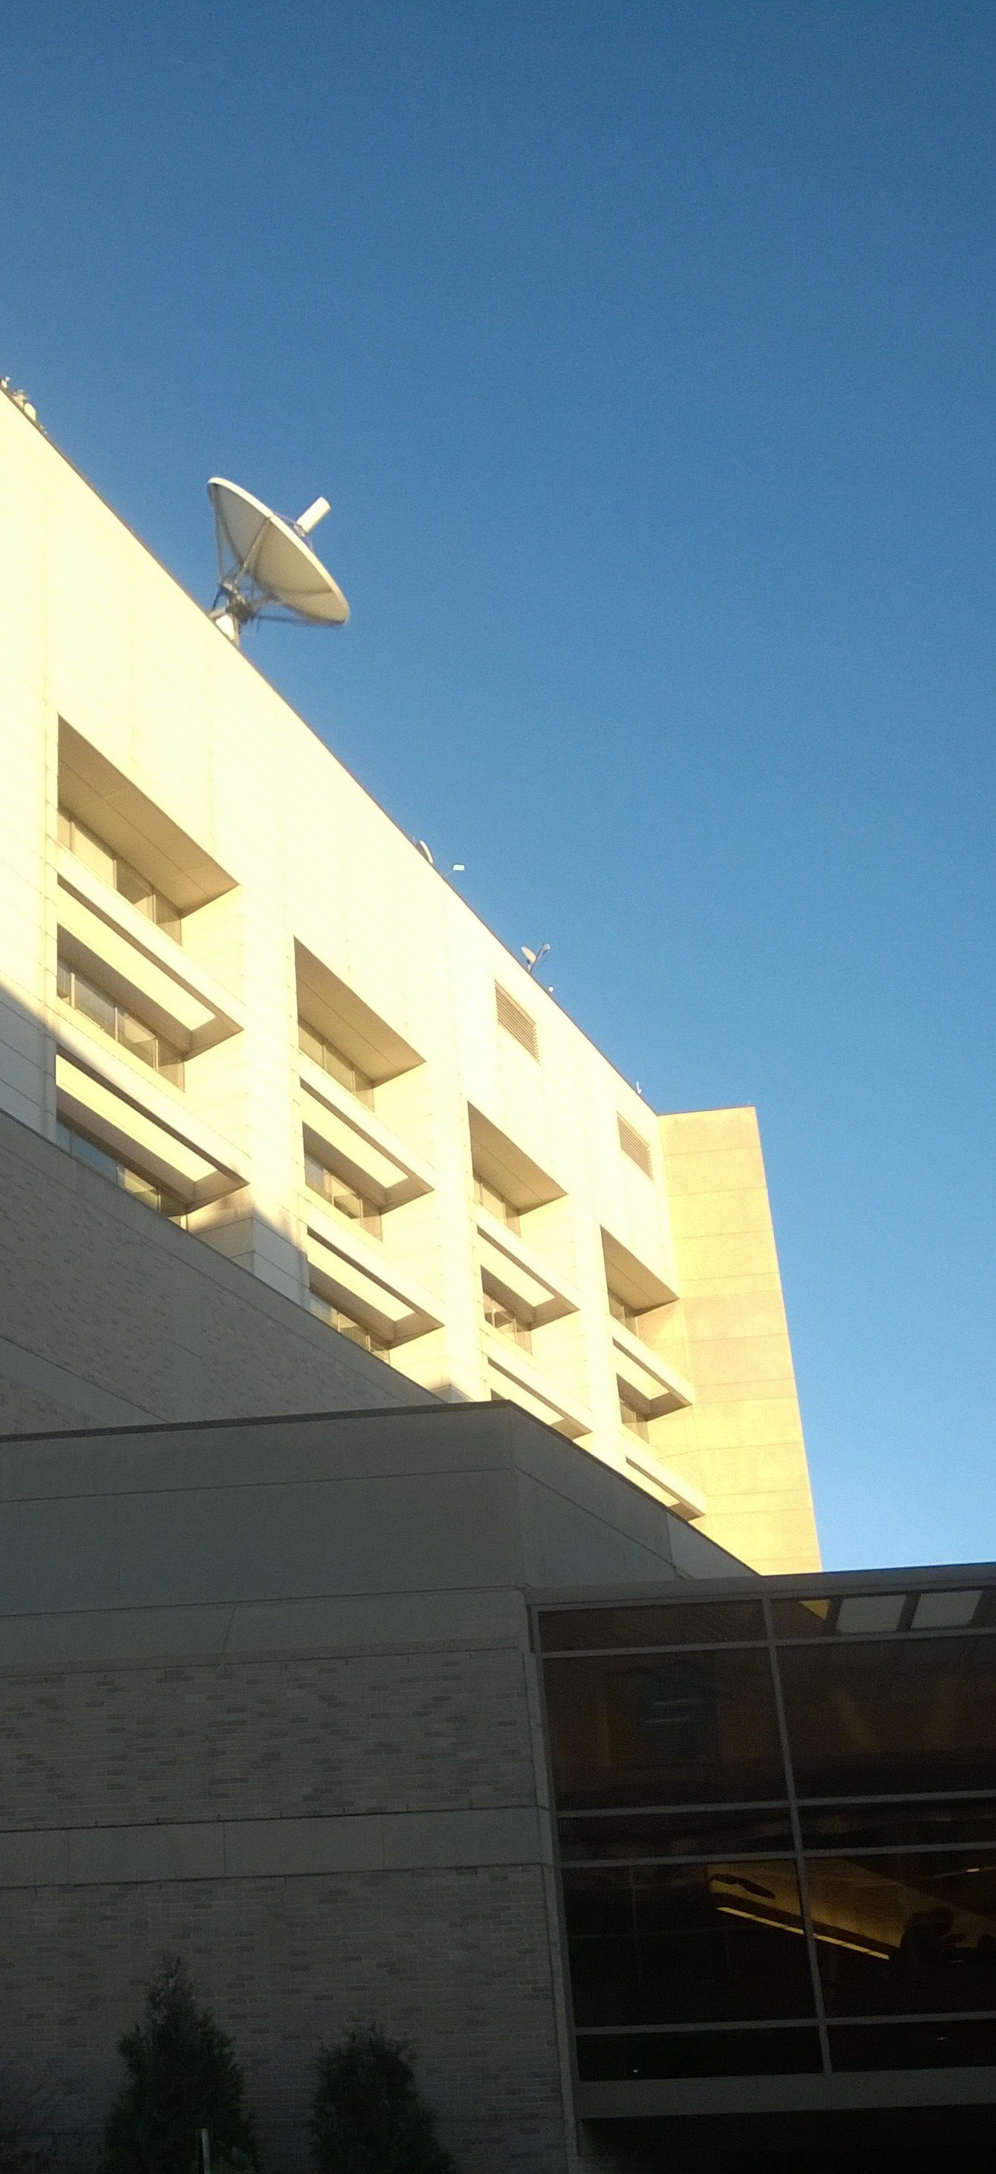


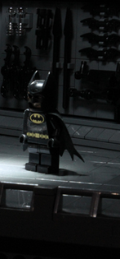
The Fortress of
Computer Science (1990s)
Welcome to
the Batcave

Slide 4
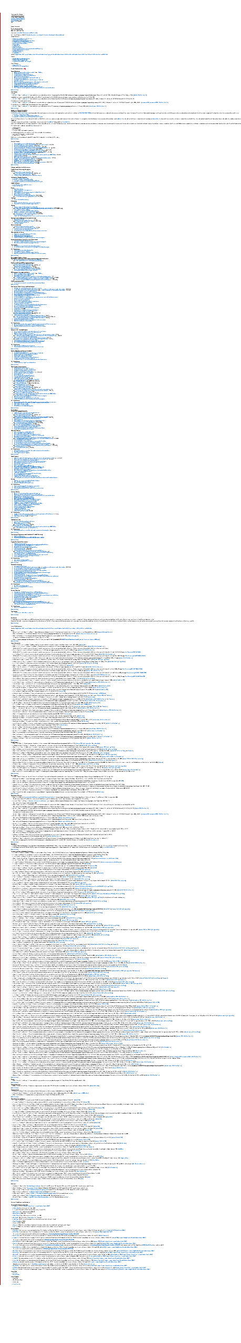
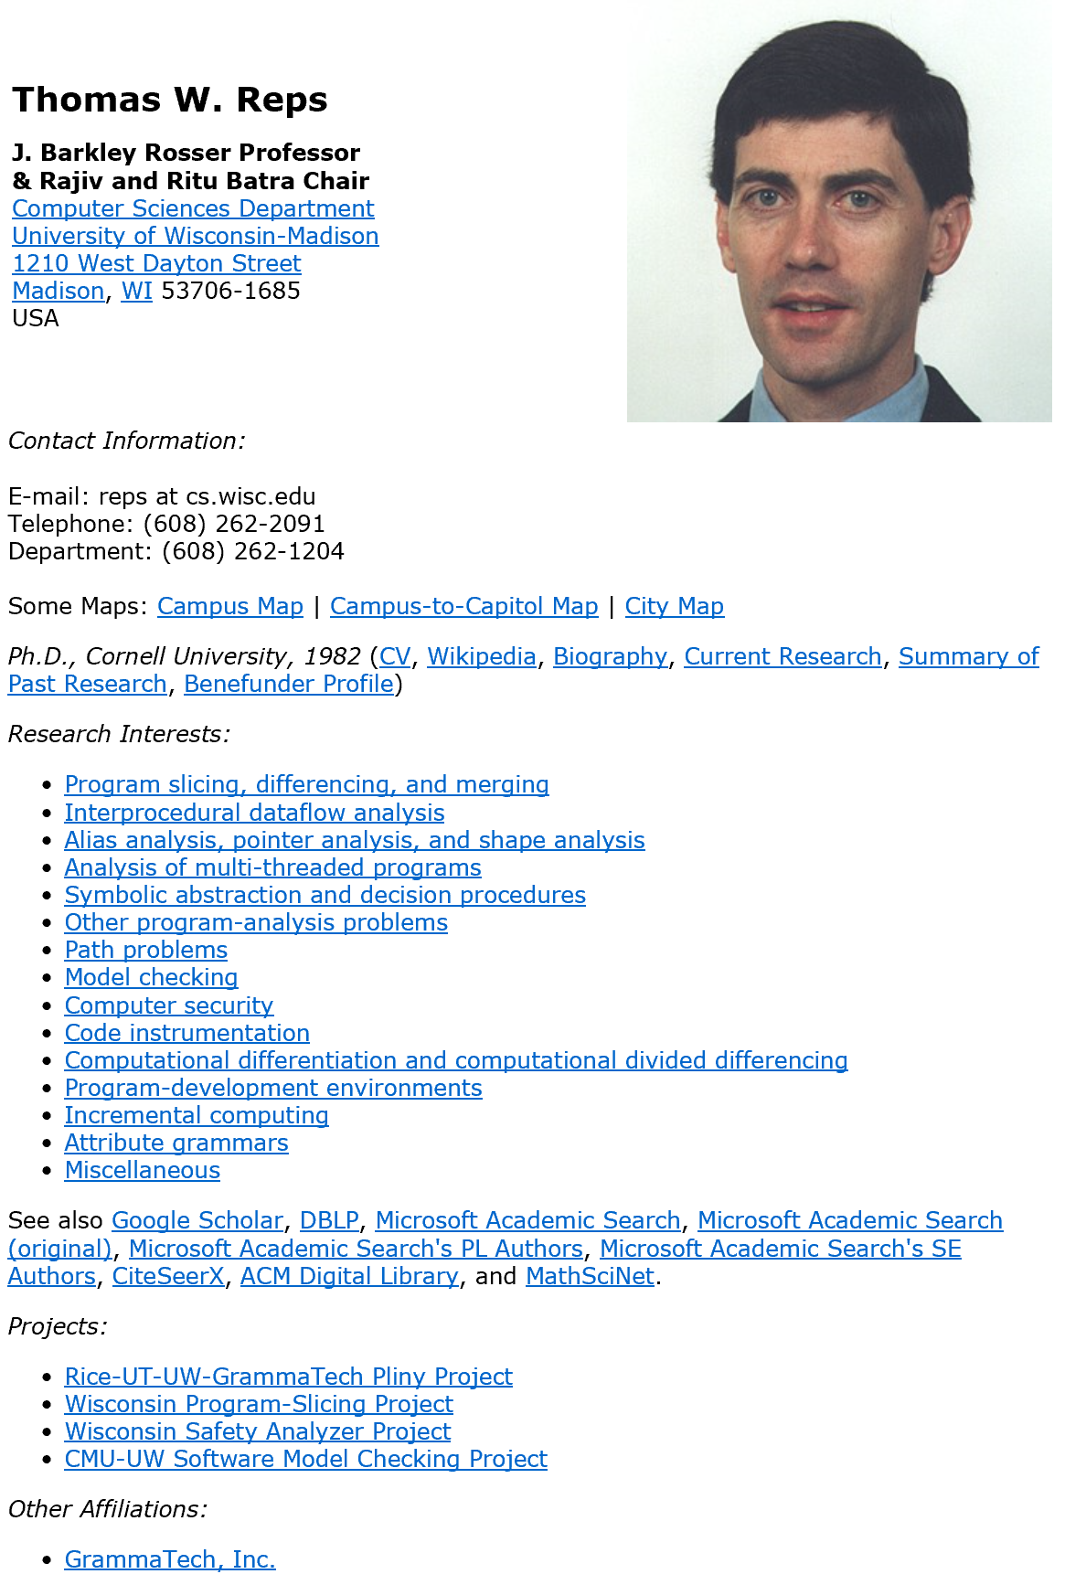
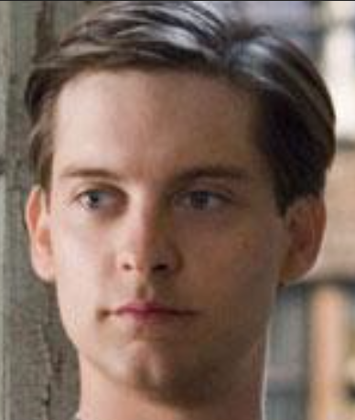
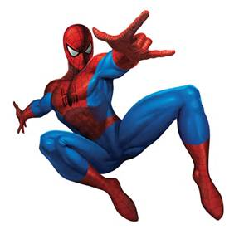
You will not escape my web!!!

Slide 5
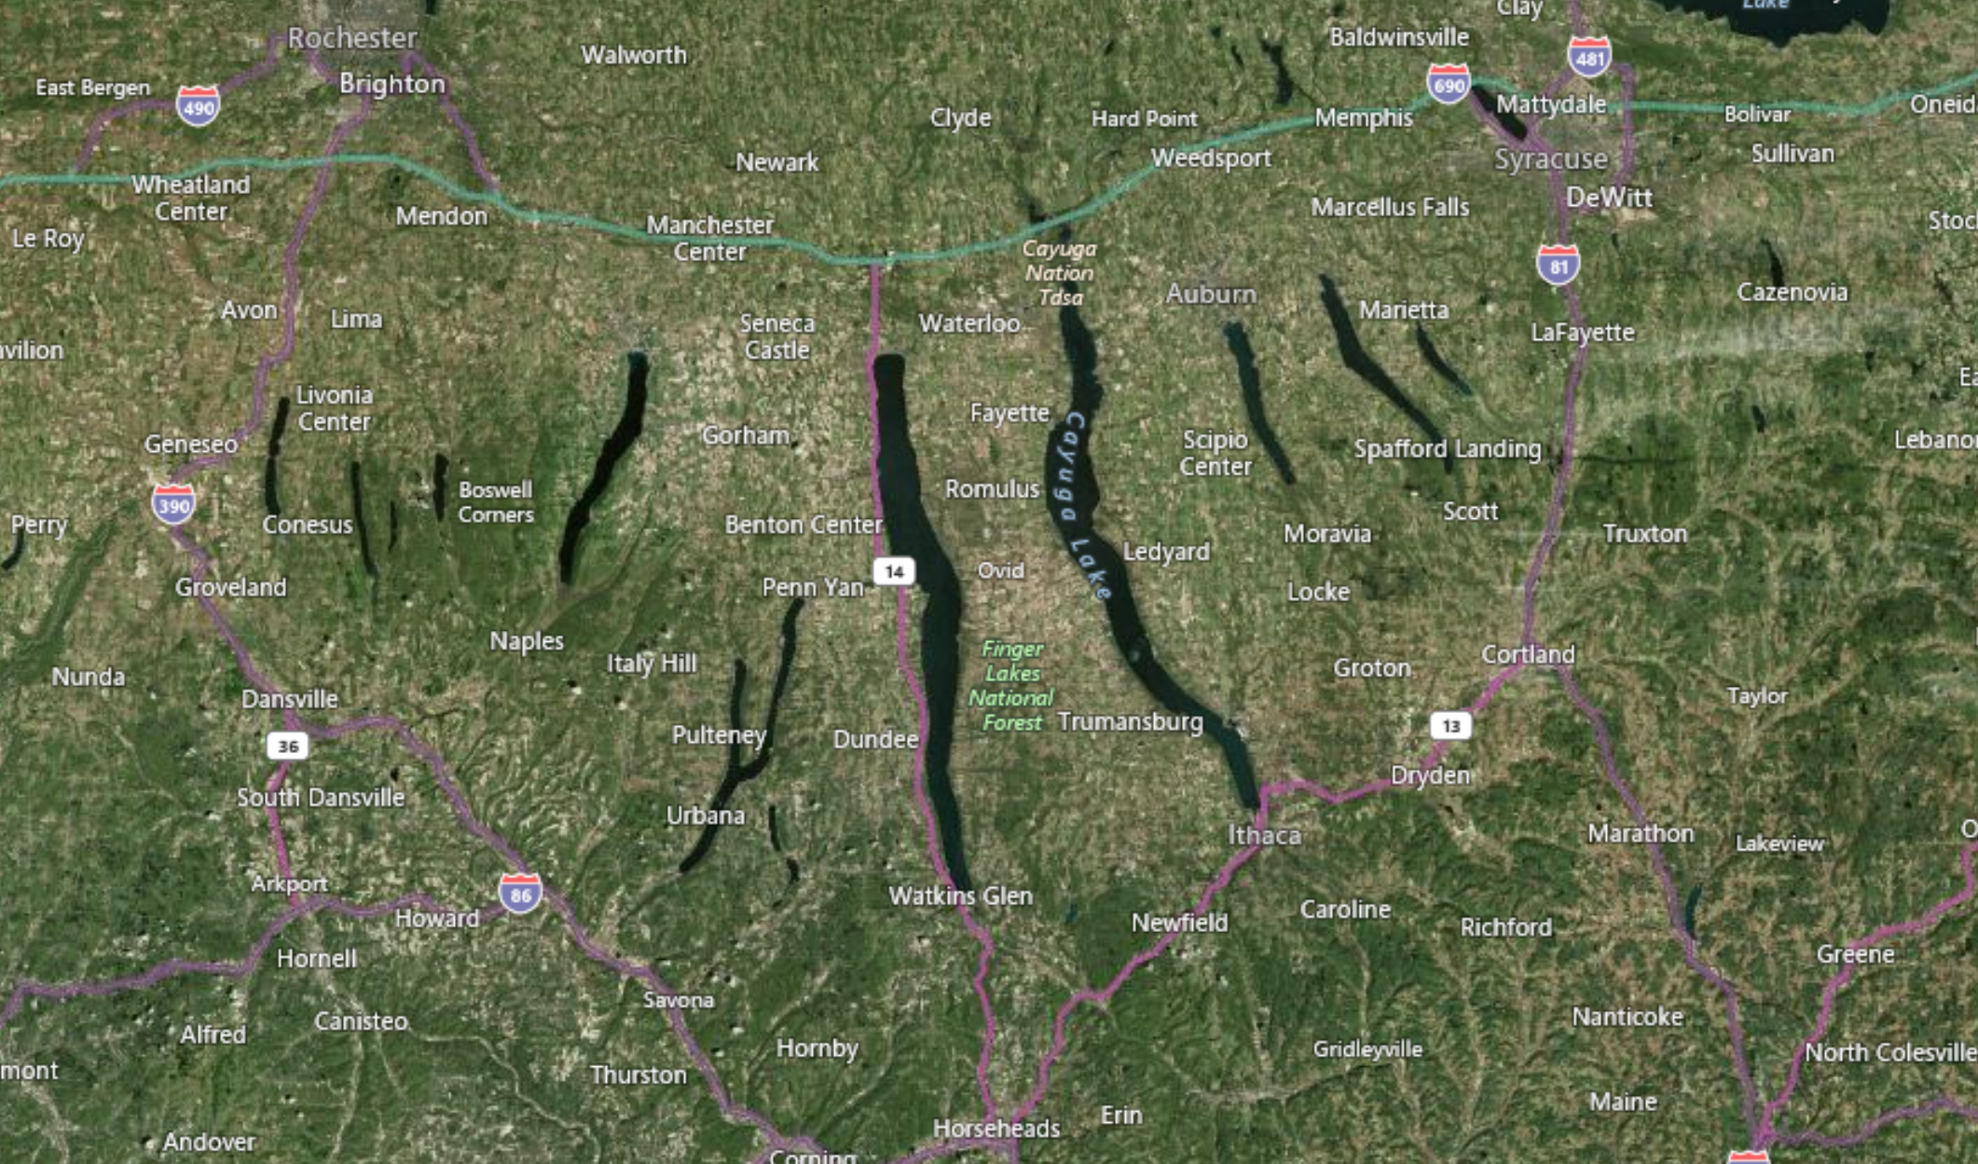
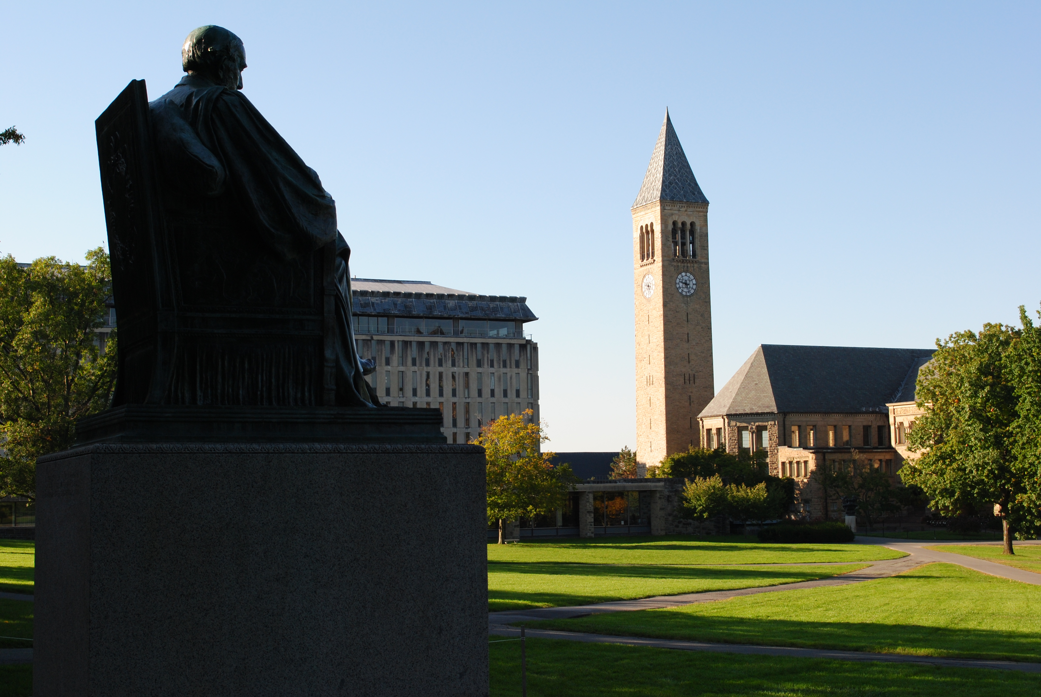
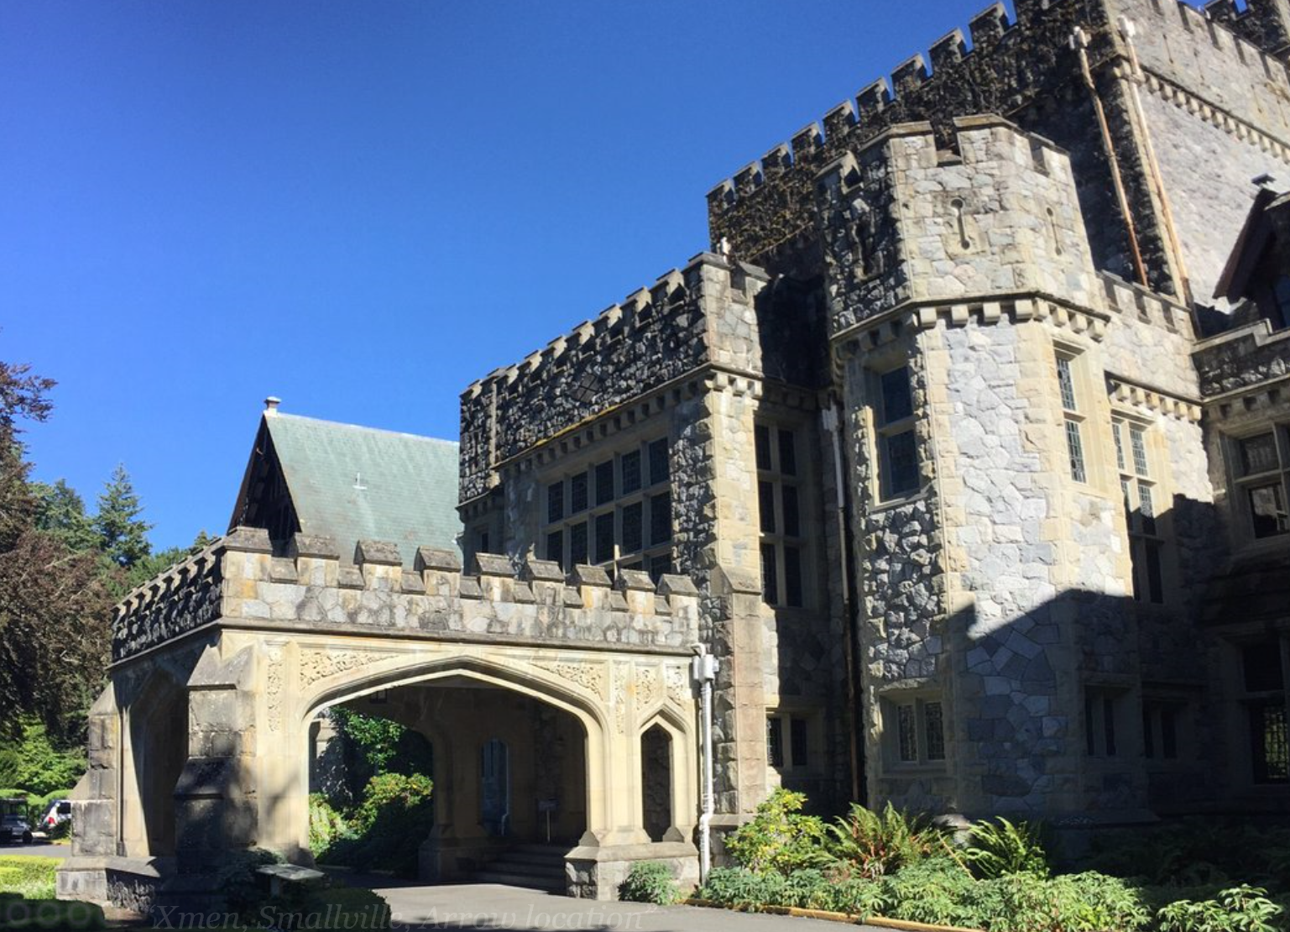

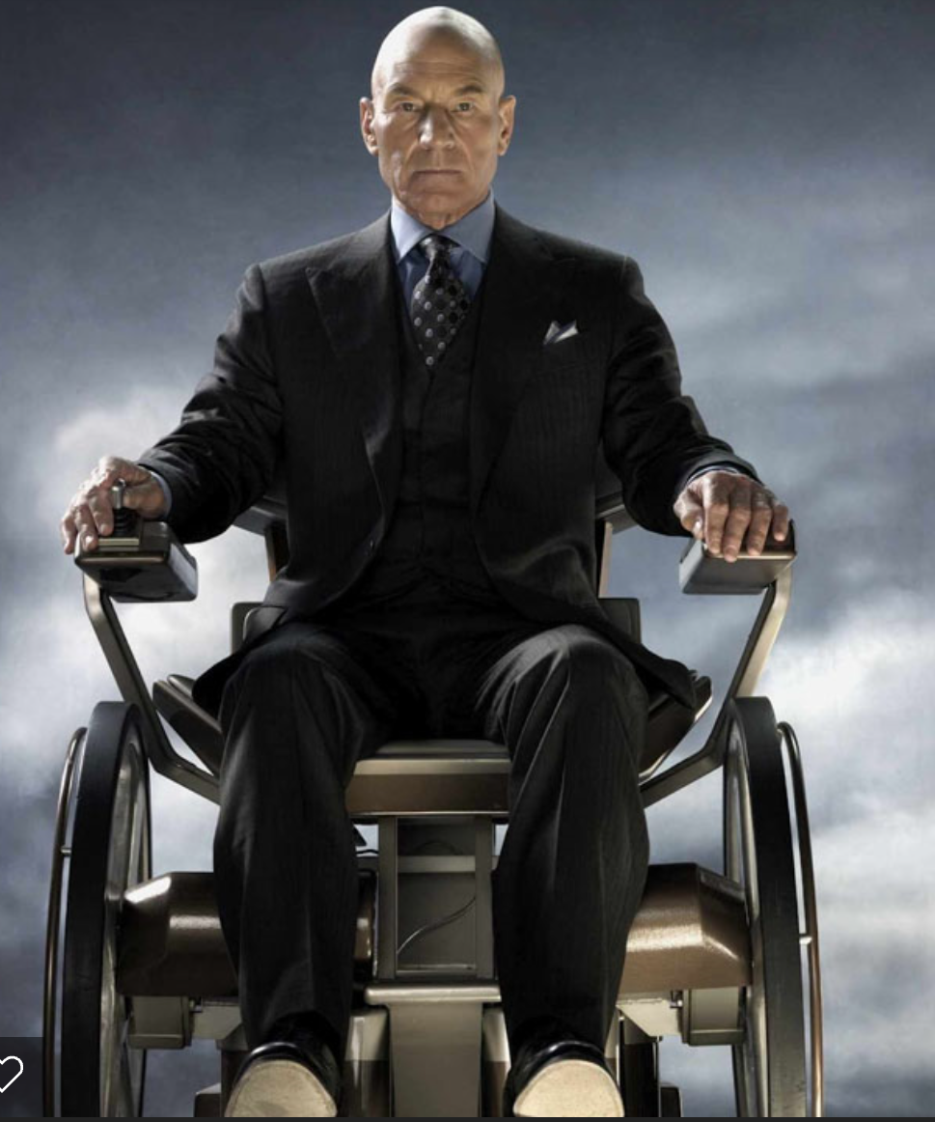

Slide 6
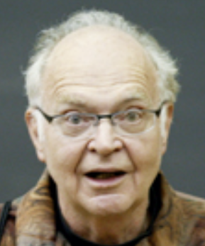
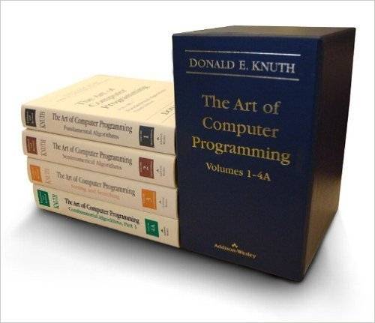
GrammaTech & X-Men
“Attribute grammars were born in the exhilarating days of the mid-60s when a great many fundamental principles of computer science were beginning to be understood.”
Mutatis mutandis
Attribute Grammars (AGs)
Just a nice mathematical formalism?
The Synthesizer Generator
Generating language-based environments from AGs!
Incremental AGs
Accommodates mutations!

Slide 7
The Art of Computer Programming

Slide 8
The Mathematical Beauty of Computer Science

Slide 9
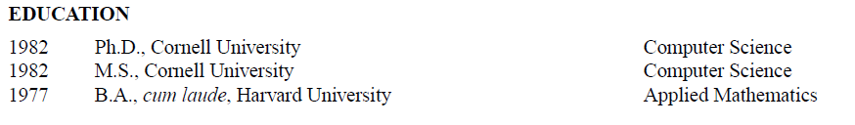
Tom’s “backstory”
Applied mathematics is a branch of mathematics that deals with mathematical methods that find use in science, engineering, business, computer science, and industry.
The term "applied mathematics" describes the professional specialty in which mathematicians work on practical problems by formulating and studying mathematical models.

Slide 10
Models, Applications
Application through Tools
Synthesizer Generator
WPIS
Code Surfer
TVLA
Code Sonar
Models
Attribute grammars
Program dependence graphs
CFL-reachability (-> path problems)
Shape graphs, 3-valued logic
Symbolic abstraction
Some lessons learnt
Model semantics
Model invariants
Proofs
Algebras
Generalize

Slide 11
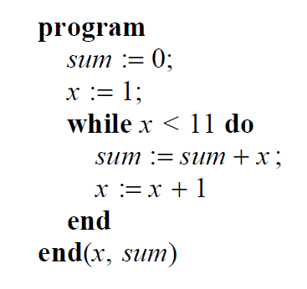
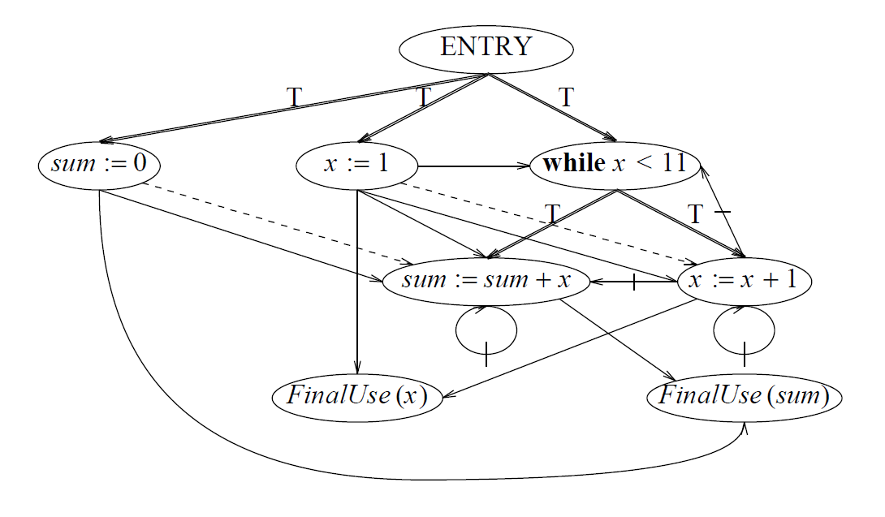
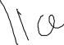

The Program Dependence Graph (PDG)

Slide 12
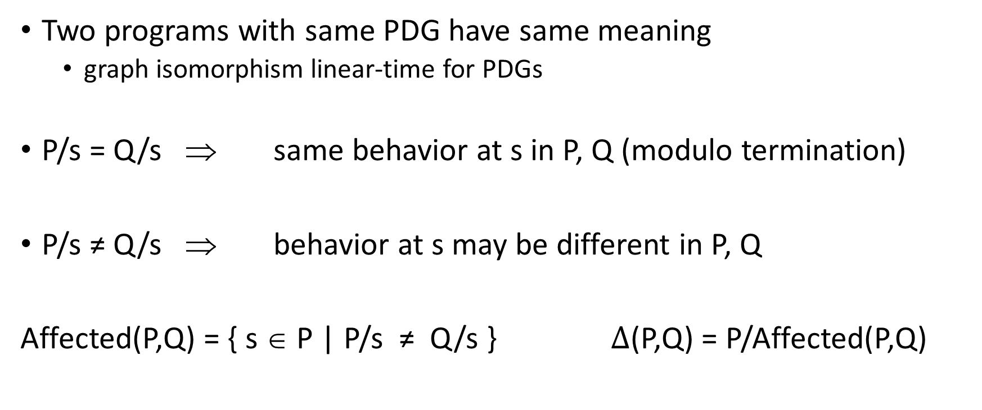
Semantics/Adequacy of PDGS and Slices
Two programs with same PDG have same meaning
graph isomorphism linear-time for PDGs
P/s = Q/s ⇒ same behavior at s in P, Q (modulo termination)
P/s ≠ Q/s ⇒ behavior at s may be different in P, Q
Affected(P,Q) = { s ∈ P | P/s ≠ Q/s } $Δ$(P,Q) = P/Affected(P,Q)

Slide 13



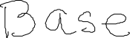
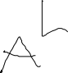
Program Integration

Slide 14


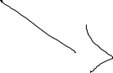
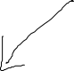
Program Integration

Slide 15
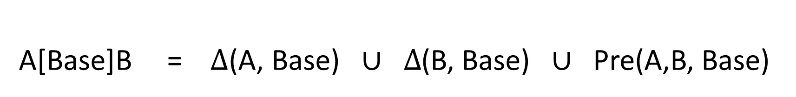
Program Integration (HPR)
A[Base]B = $Δ$(A, Base) $∪ Δ$(B, Base) $∪$ Pre(A,B, Base)

Slide 16
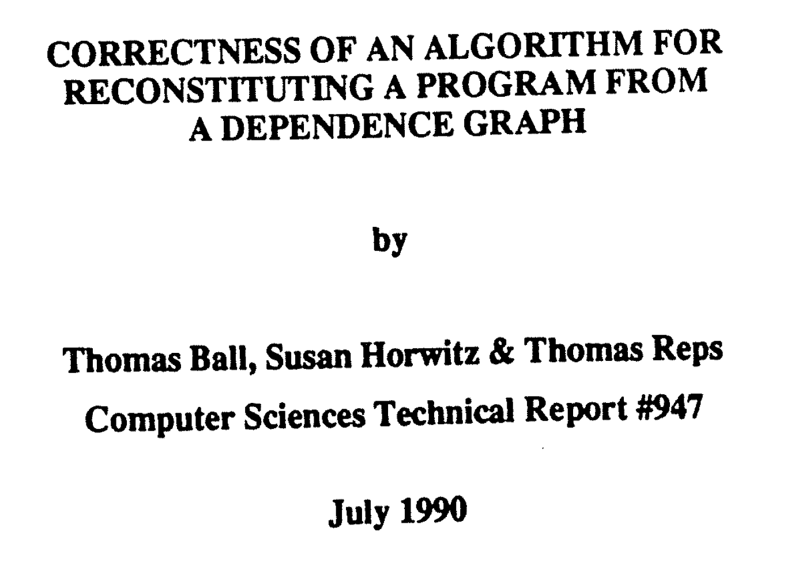
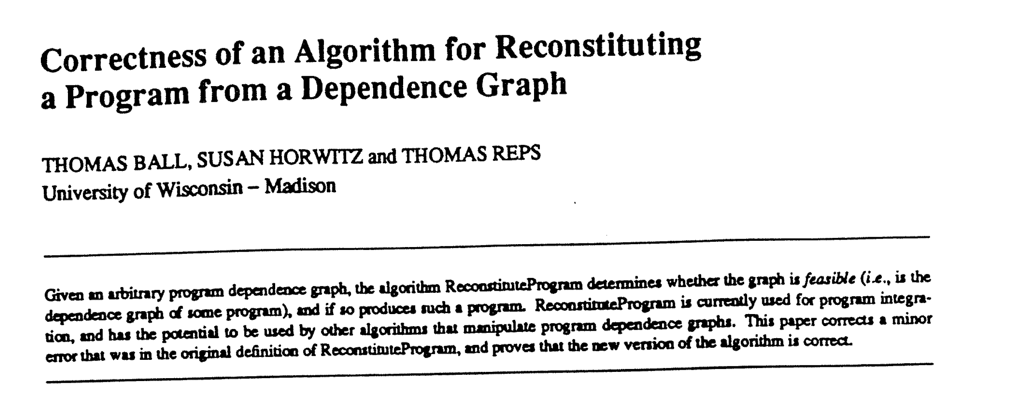

Slide 17
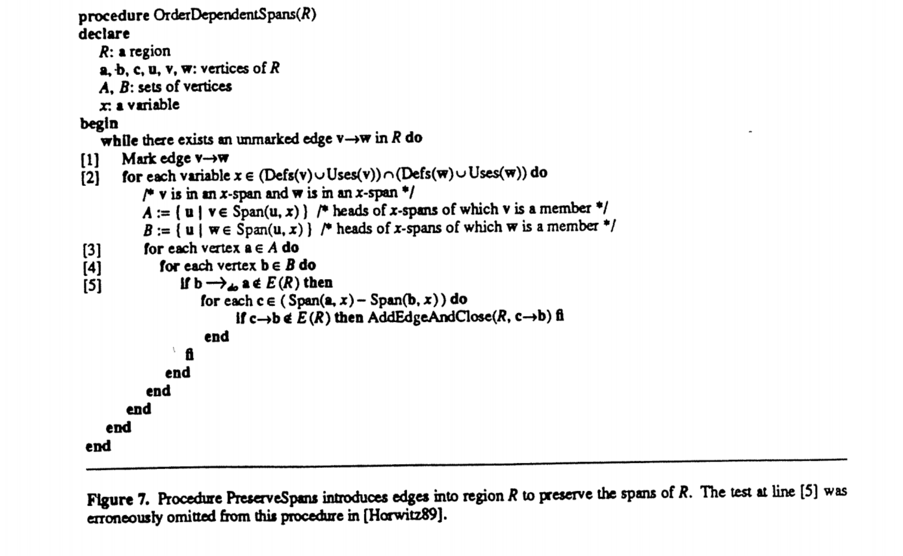
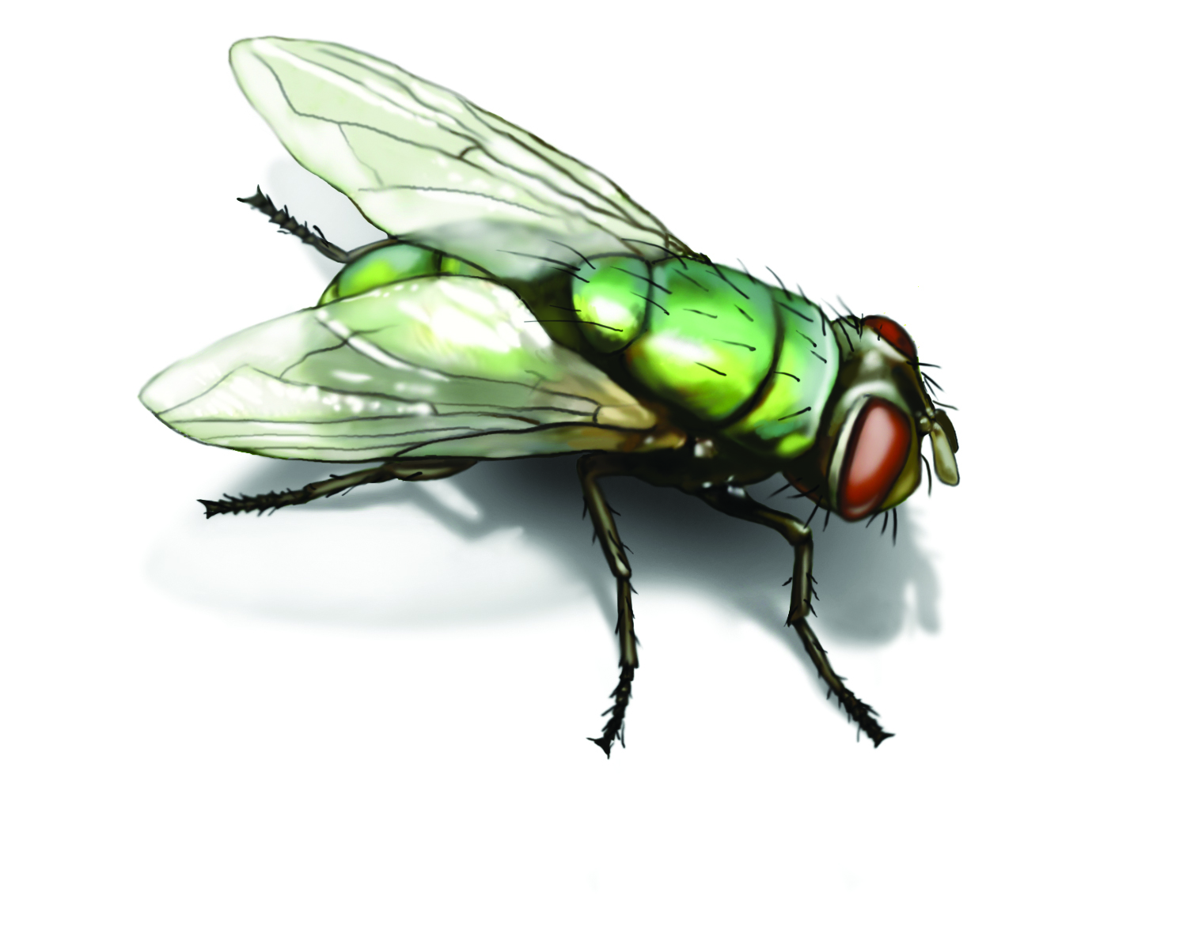

Slide 18
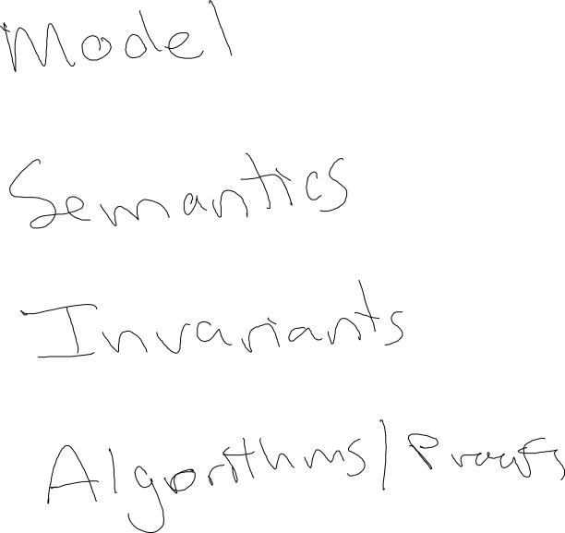

Slide 19
Algebraic Properties
of
Program Integation
http://research.cs.wisc.edu/wpis/papers/scp91.pdf

Slide 20
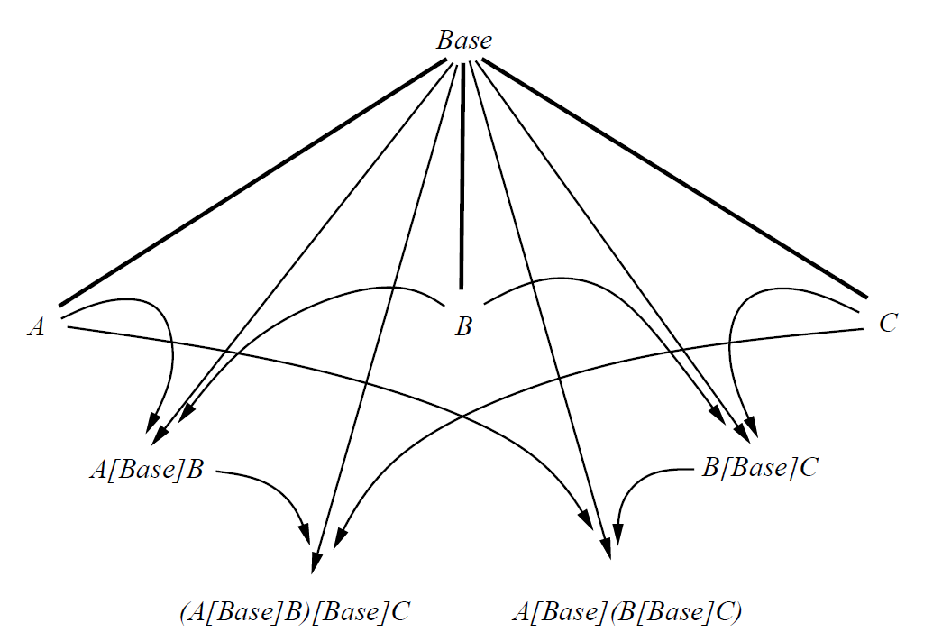
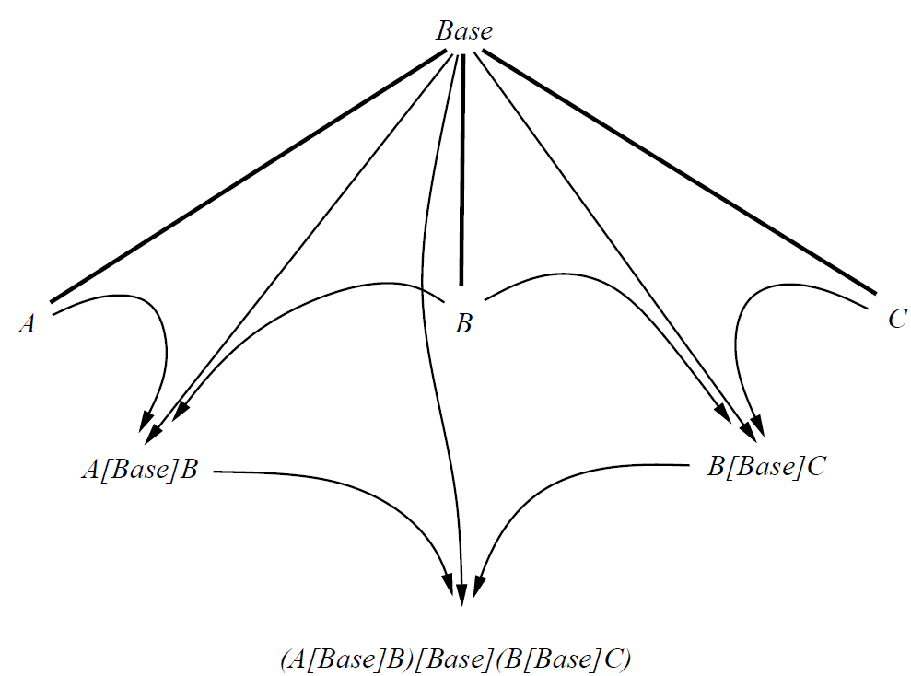
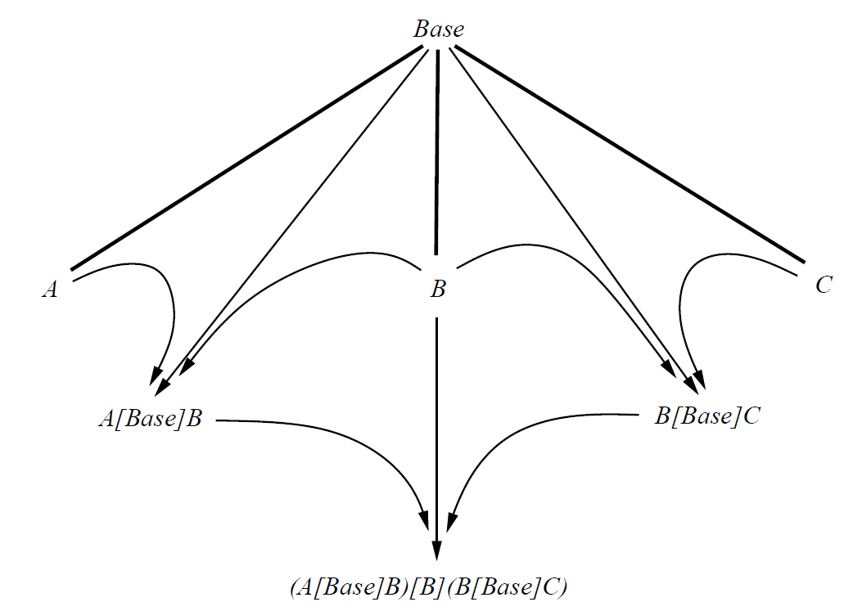
Is A[Base]B associative?

Slide 21
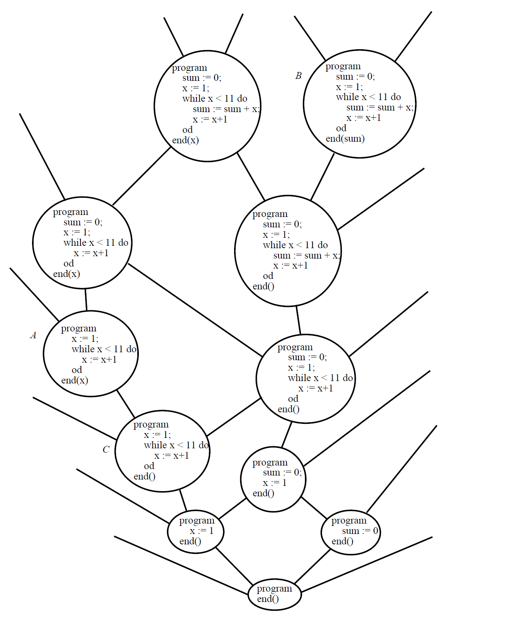
Notes:
Lattice of PDGs = ordering is a slice of

Slide 22
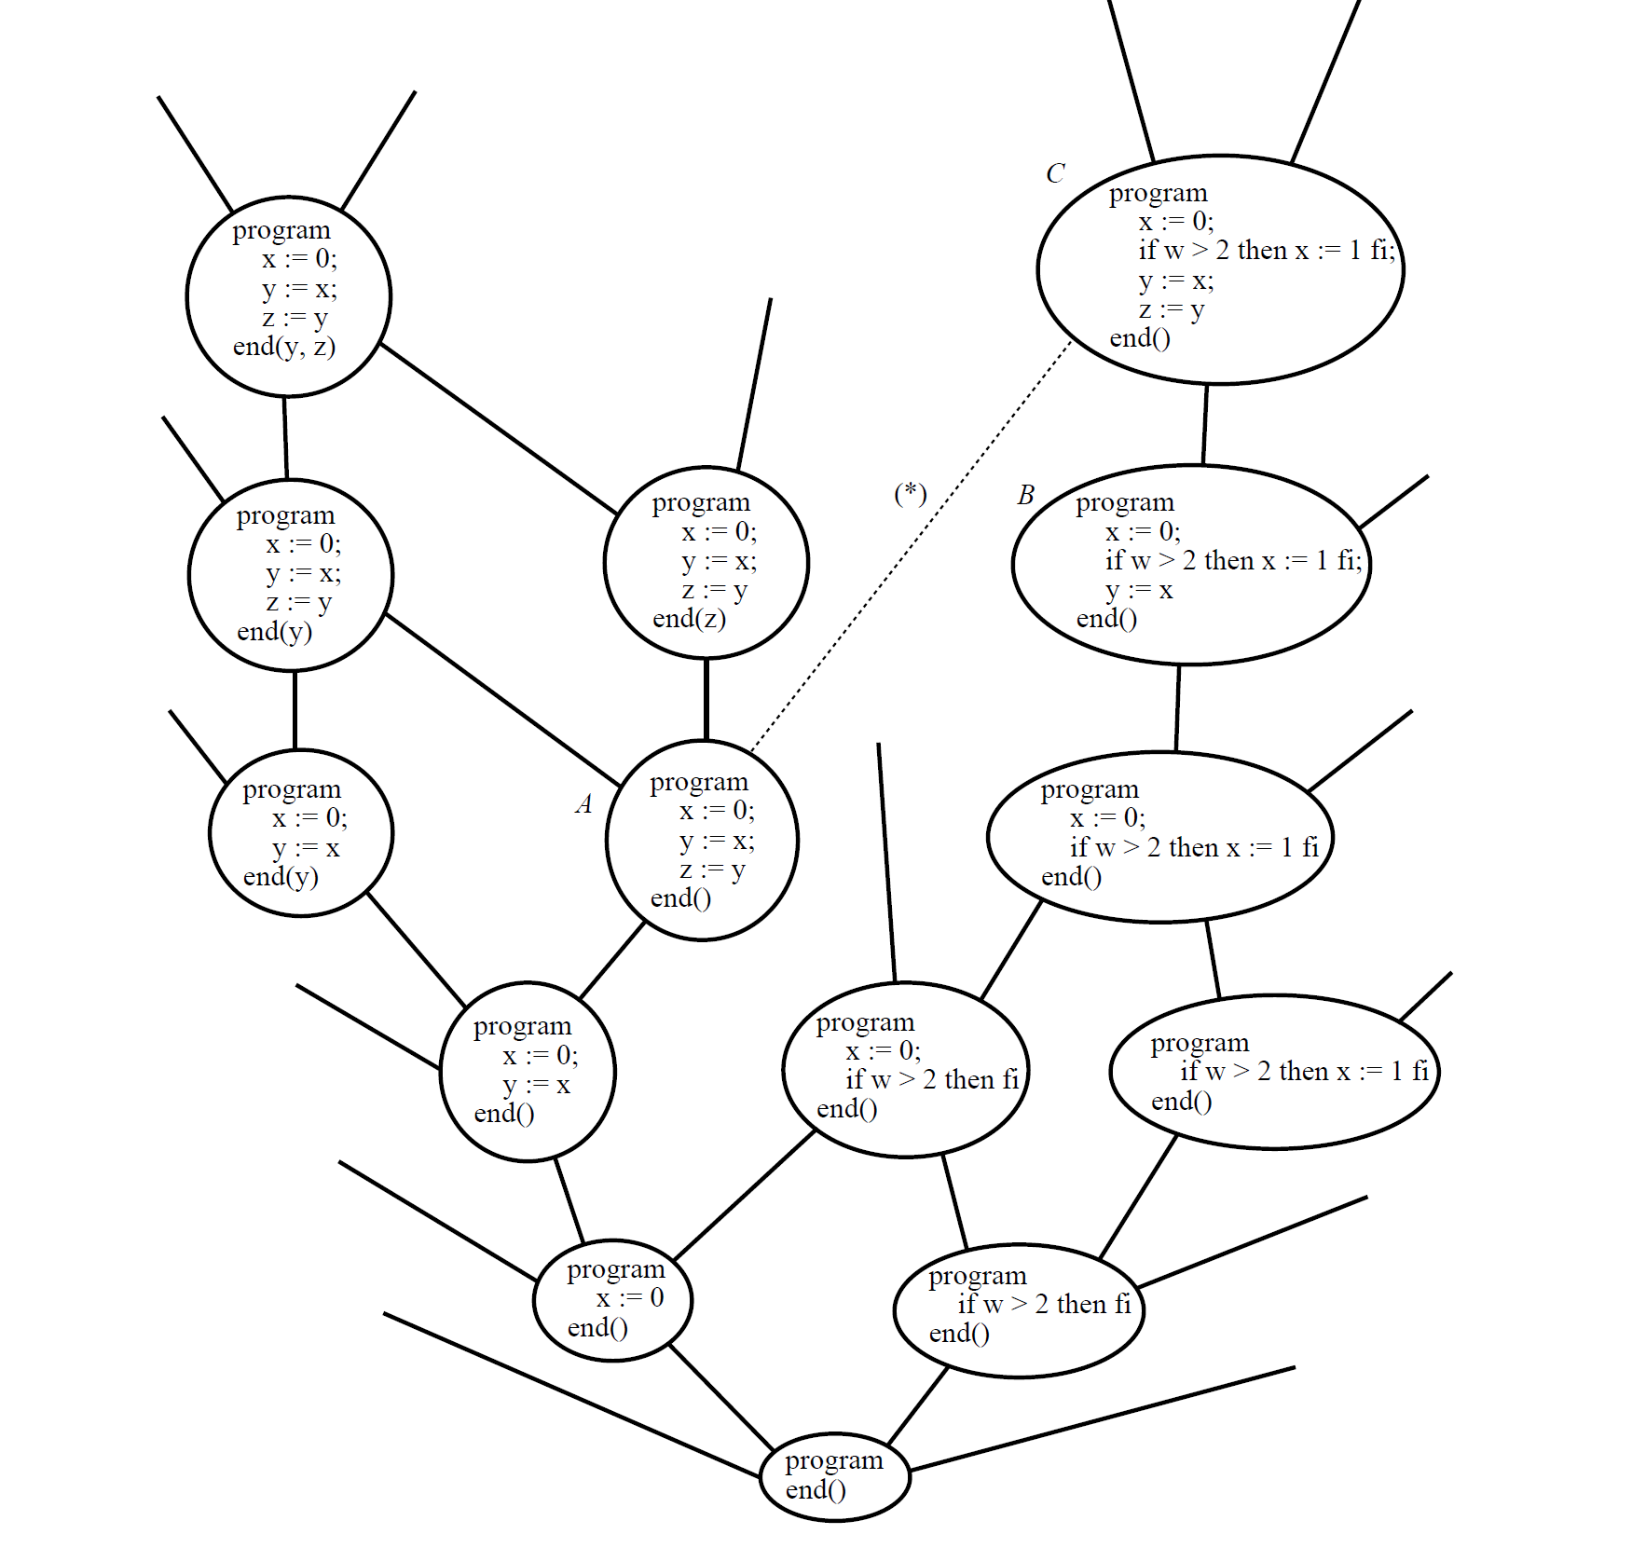
No join
operation!

Slide 23
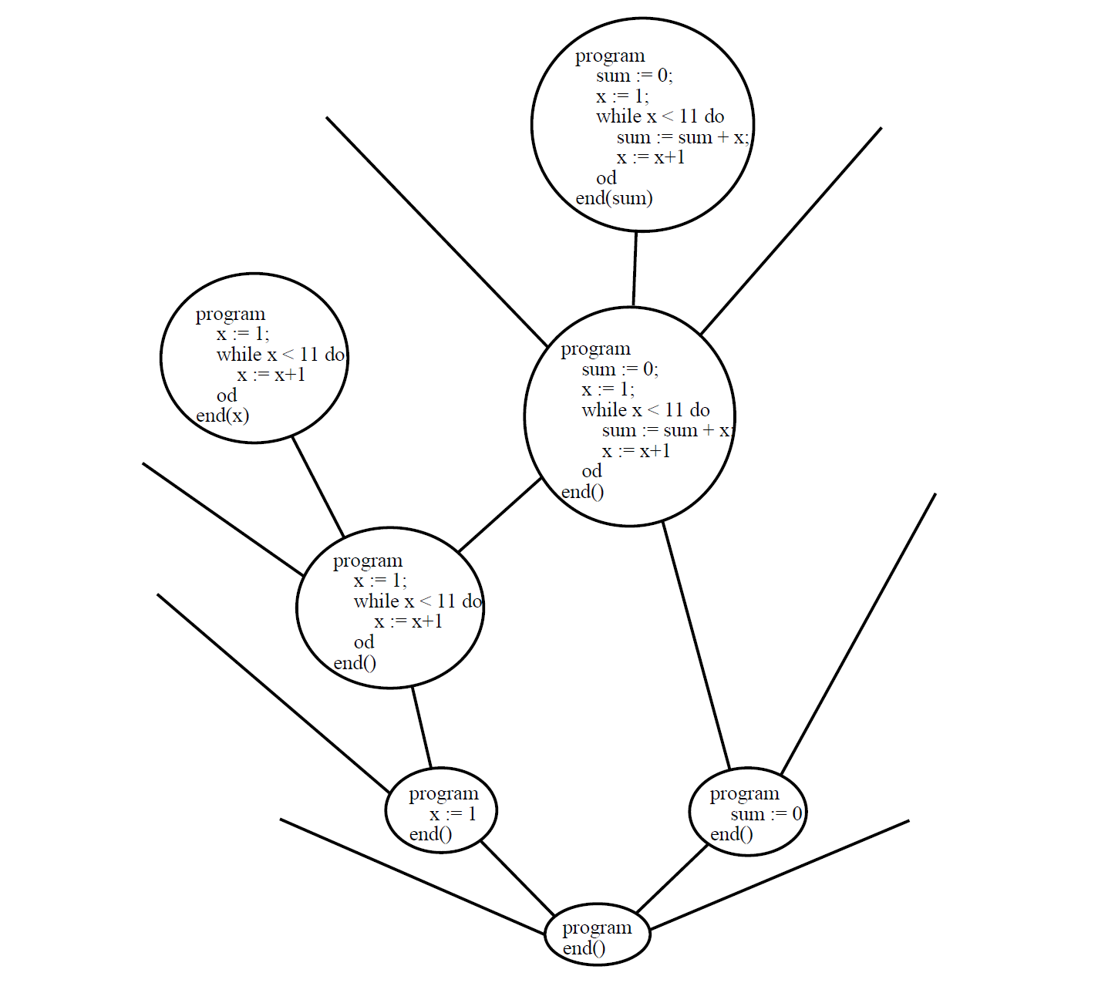

Slide 24
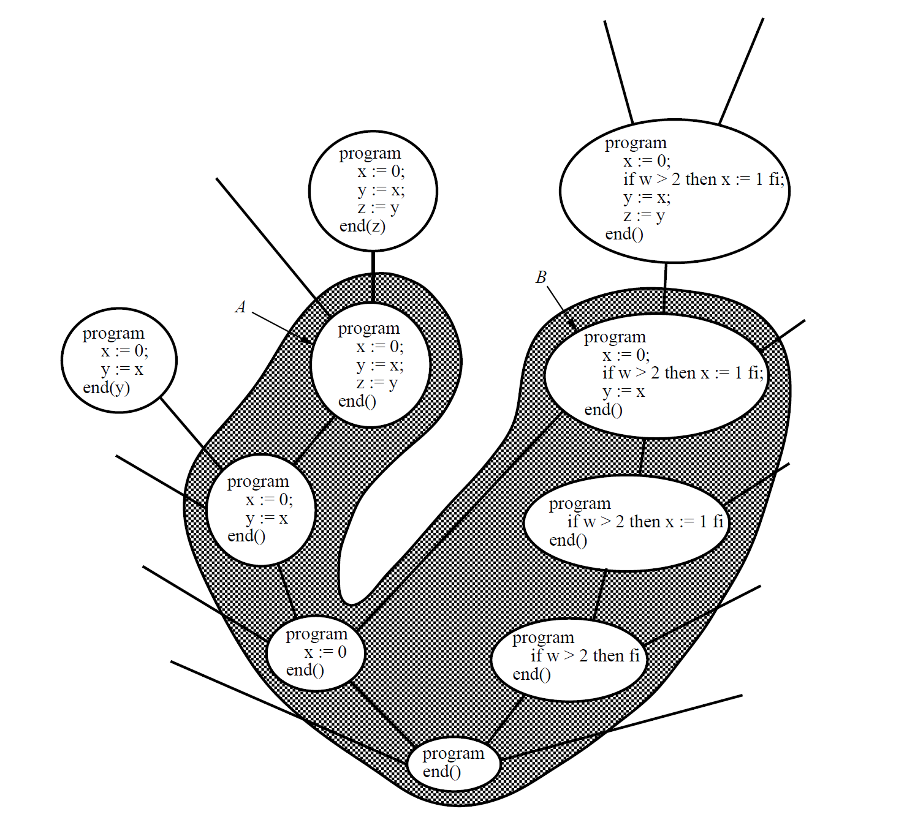

Slide 25
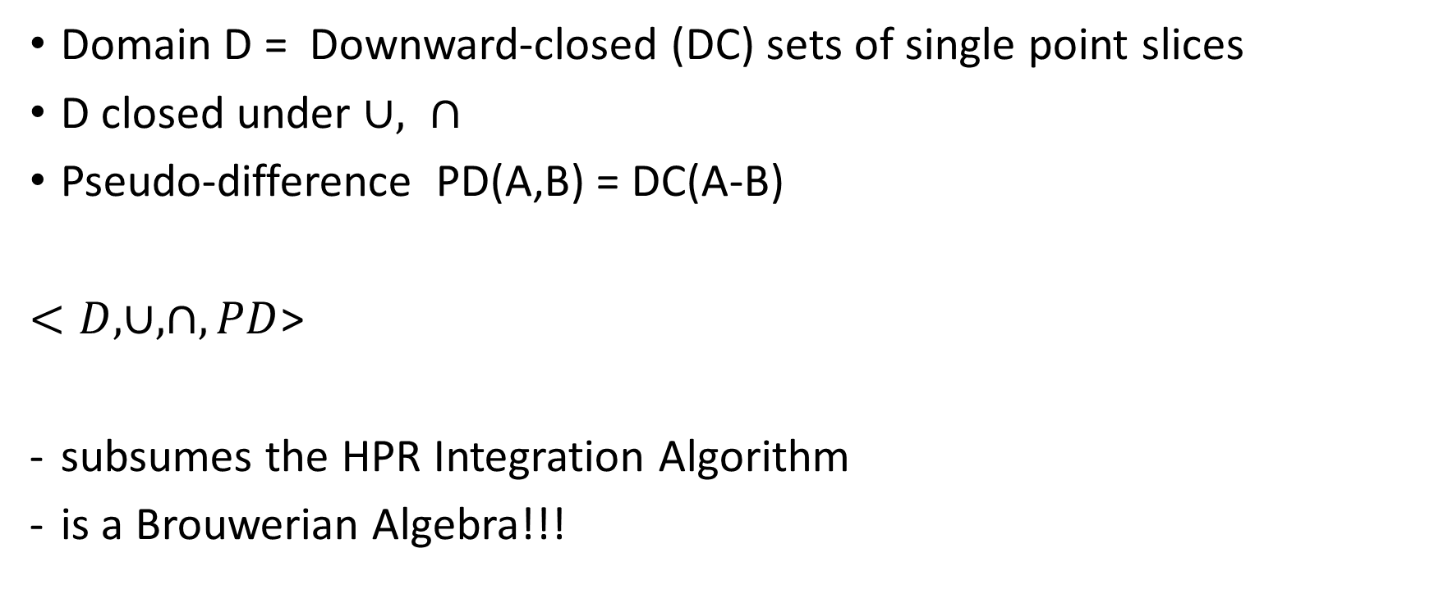
HPR and Brouwerian Algebras
Domain D = Downward-closed (DC) sets of single point slices
D closed under $∪, ∩$
Pseudo-difference PD(A,B) = DC(A-B)
$<D, ∪, ∩, PD$>
subsumes the HPR Integration Algorithm
is a Brouwerian Algebra!!!

Slide 26
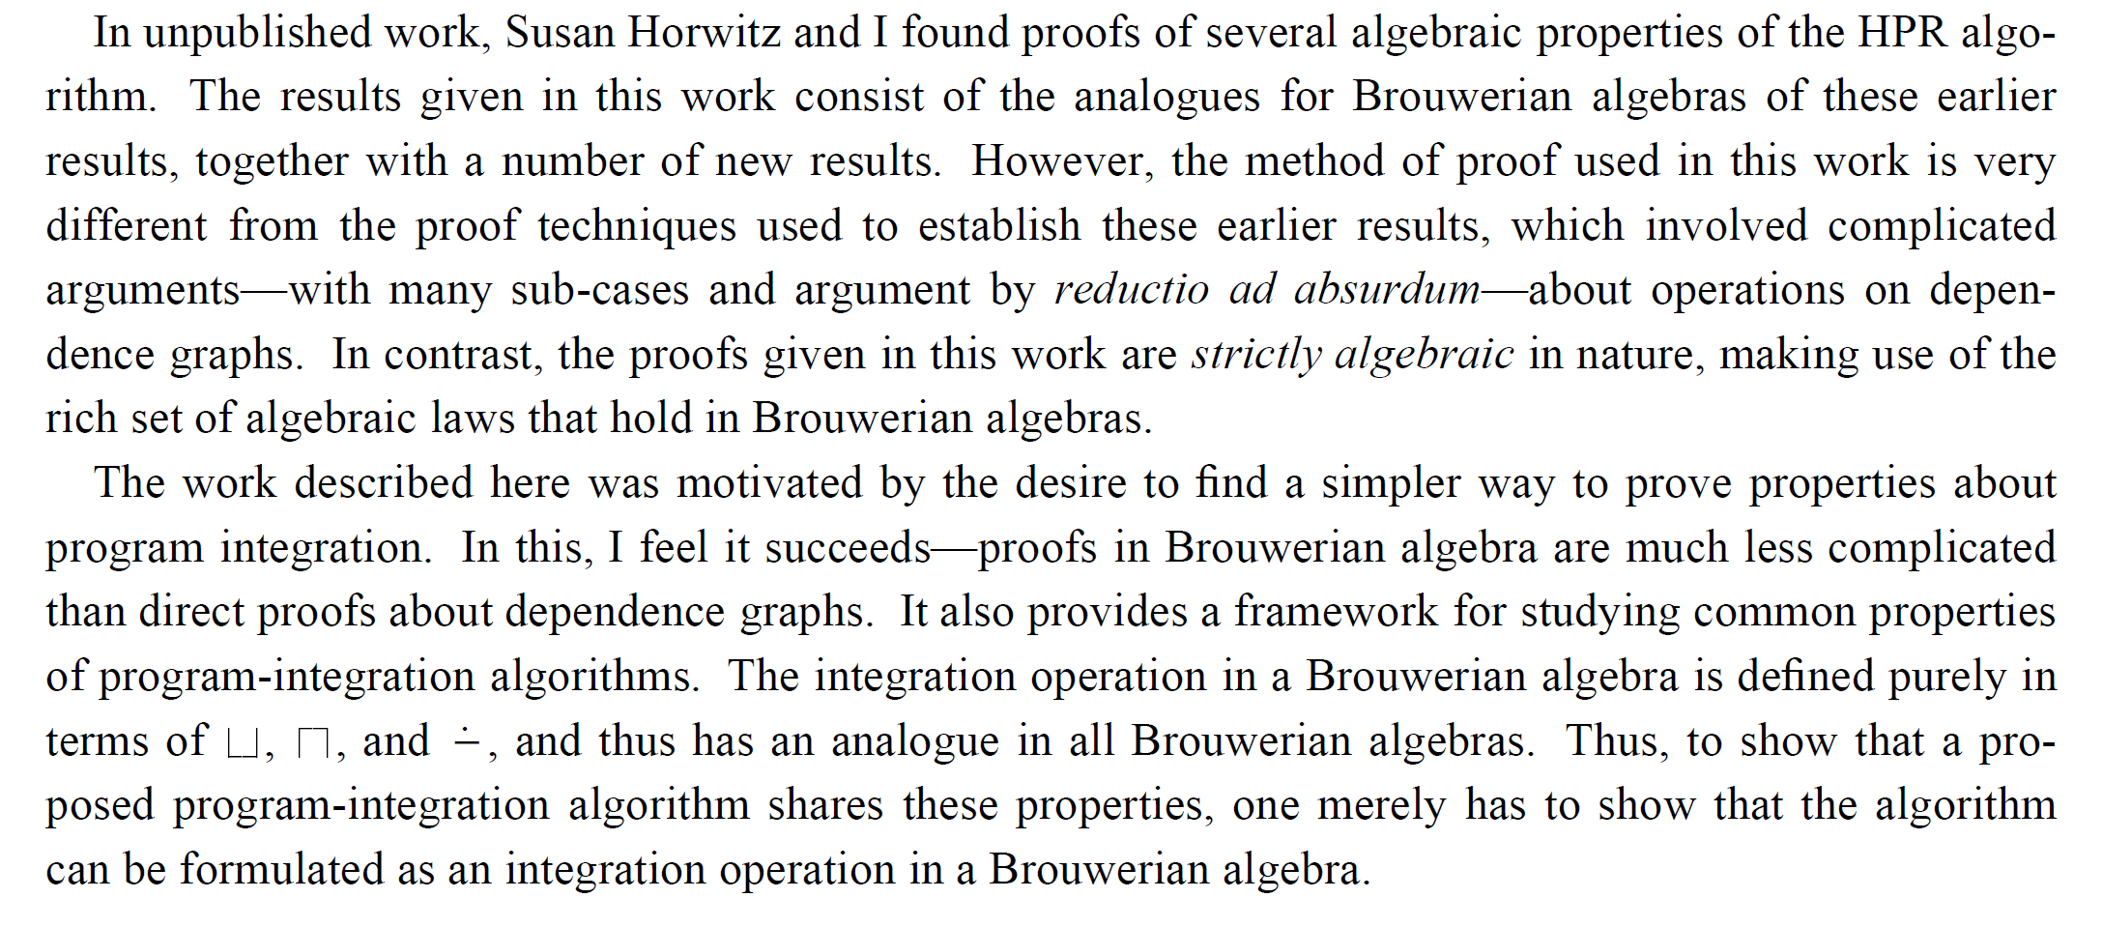

Slide 27
You will not escape my web!!!

Slide 28
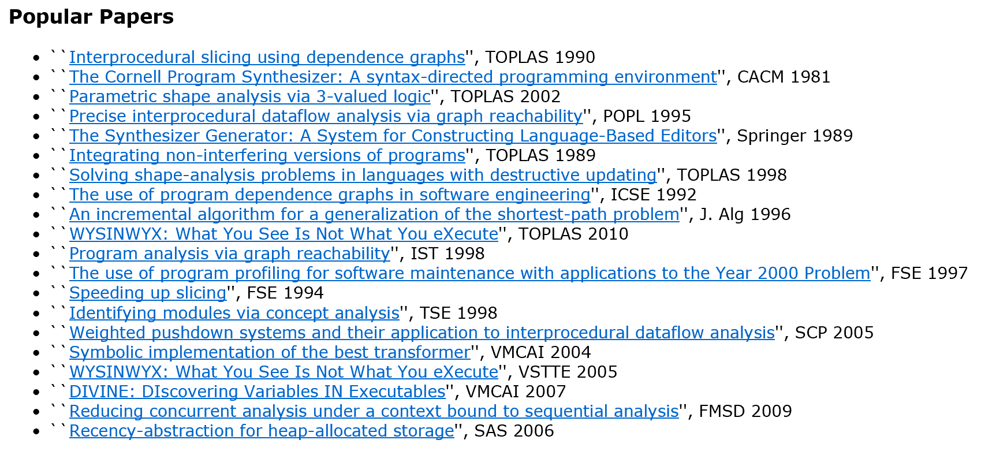

Slide 29
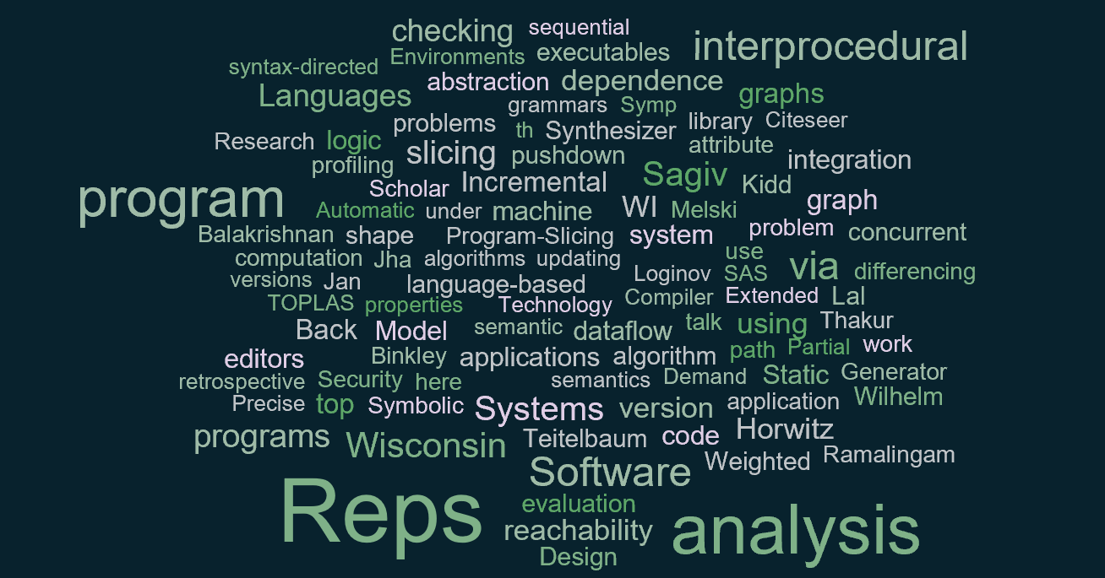


Slide 30
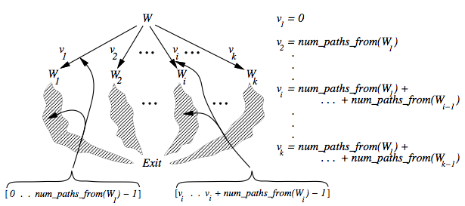
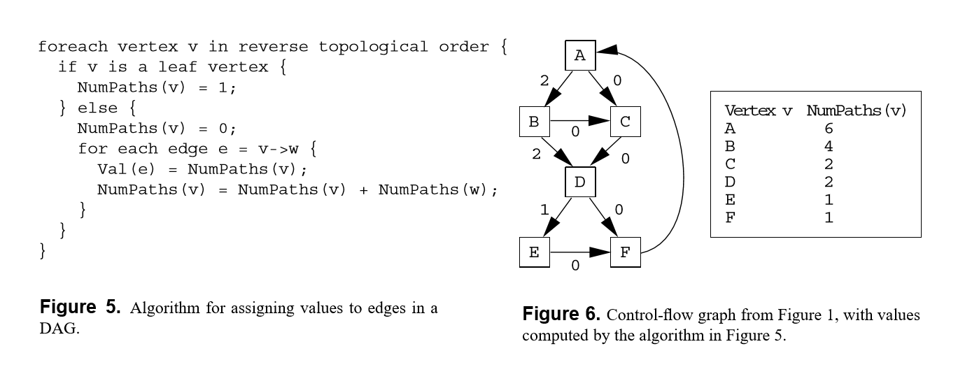
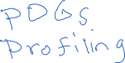
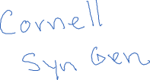
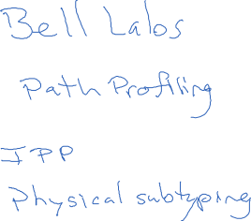


Slide 31
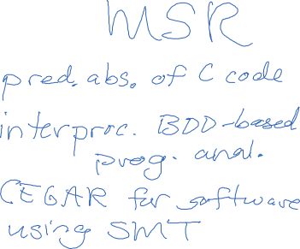


Slide 32
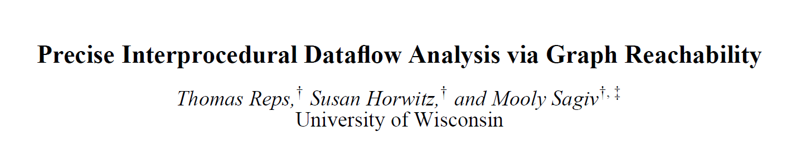
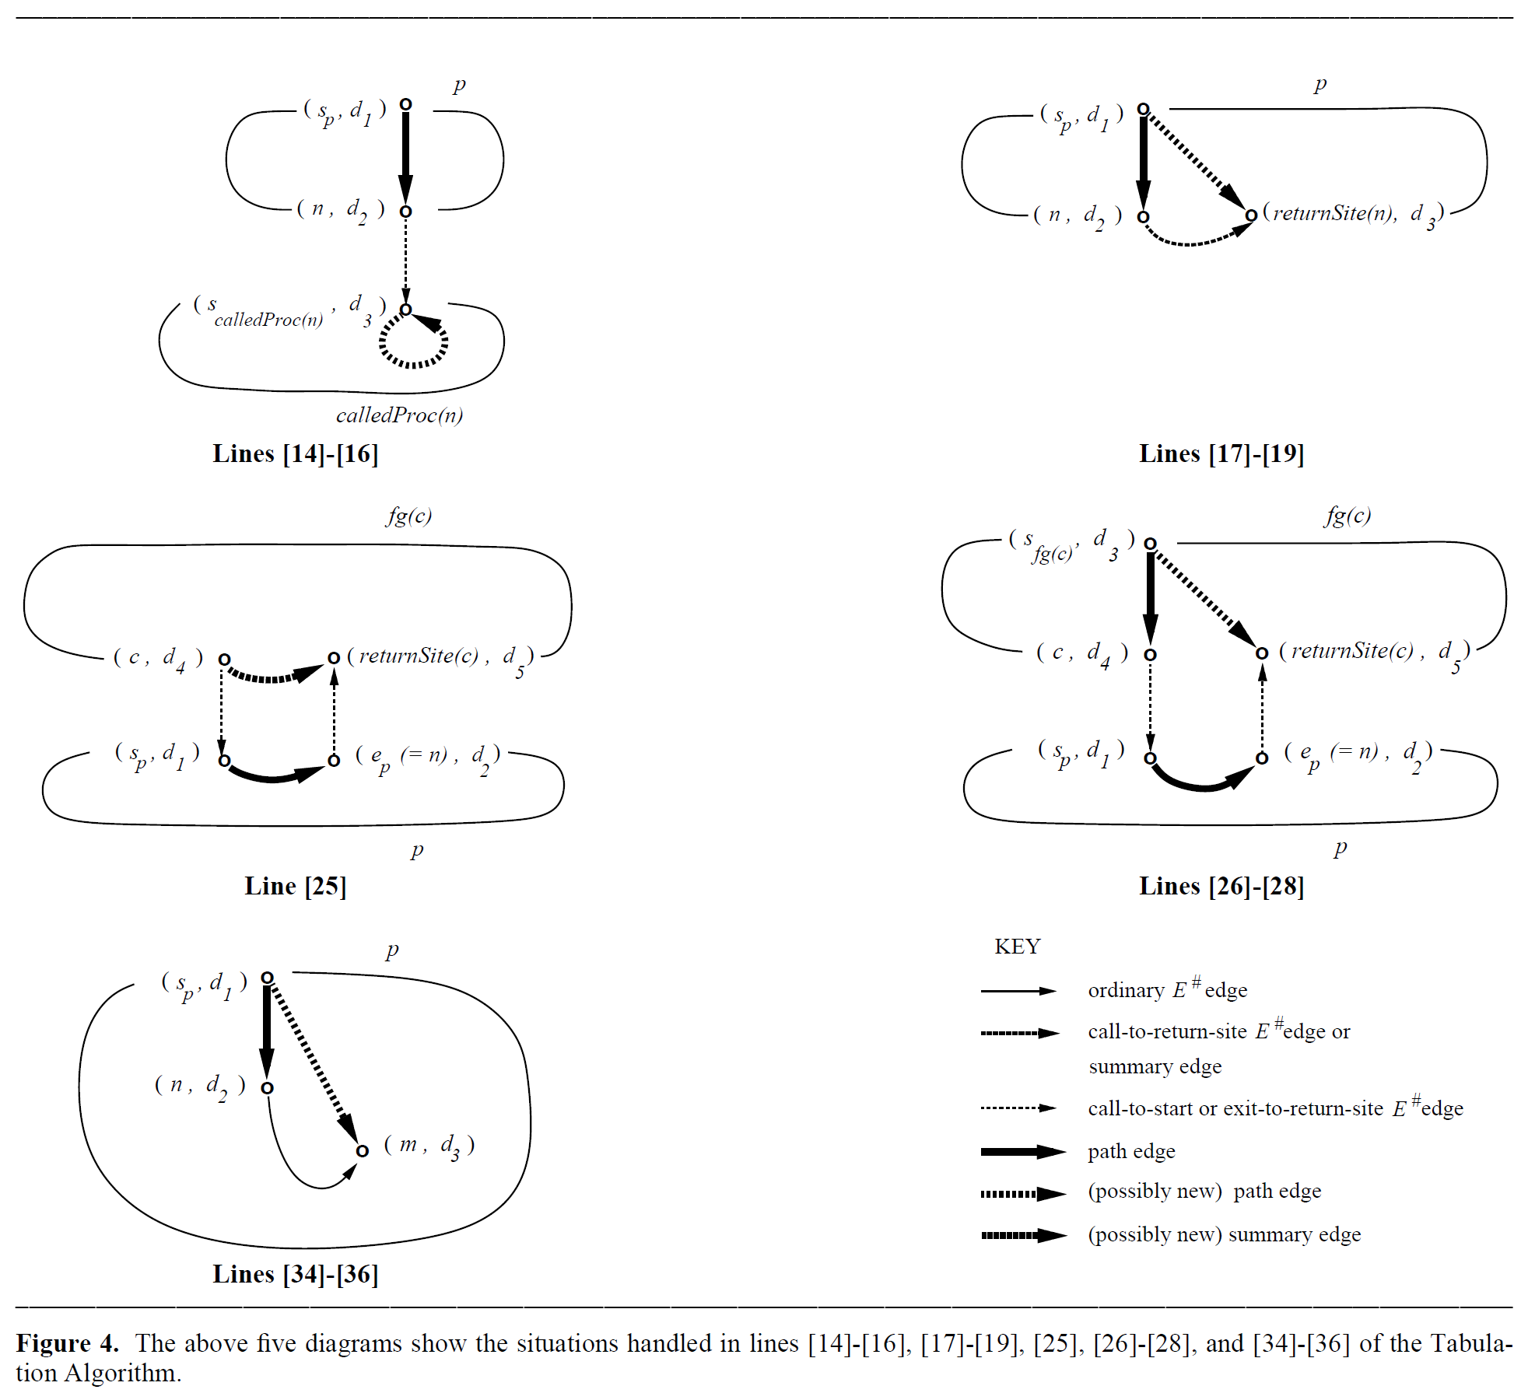
Bebop
SLAM/SDV
ESP
…

Slide 33
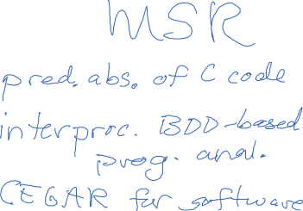

Slide 34





Angelic
Verification
2016
Driver Quality Team
Corral
Yogi
SLAM2
SLAM
2002

Slide 35
















Slide 36


